Slide 1
Visual Analytics Based Inventory Replenishment
Team: ML_Legends
Members: 1. G Saketh 2. G Pavan 3. Varun Kota 4. Badiganti Sameer

Slide 2
Task 01
Computing available space for the item:
The available space in the side lot is calculated as follows:
The program takes the image of the store side lot as input and calculates the two most dominant colors in the image. Since the images are a close up top views of the stores, the two most dominant colors will be that of side lot and warehouse
Then the program selects the area in the image with less color gradient, area of sidelot available space and computes the area in pixels that is covered by the empty side lot
Then we crop the lower part of the image to get the scale ratio of the image.
We perform a “Canny Edge detection” on the cropped image to get the number of pixels between the vertical edges of the scale.
Then we convert each square pixel corresponding to sq. Meters and sq. Feet

Slide 3
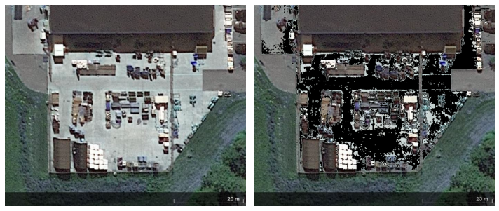
Black color in the right side image is the available space in the side lot
Source Image : store 2
Image after analysis
OUTPUT : empty_lot_pixels = 80544

Slide 4


Calculating the scale of image
Source Image : store 2
Image after canny edge detection of scale
OUTPUT :
Scale distance = 202 px
Conversion: 1 sq.px = 10.1 sq.mtrs = 108.71538999999999 sq.feet
Total Available Area = 80544 * 108.715 = 8756372.372 sq.feet

Slide 5
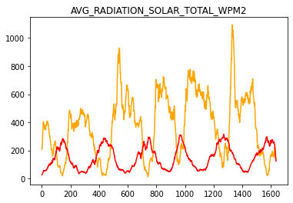
Task 02
Sales Forecast Prediction :
Dataset preparation: The datasets to train the models are prepared as follows.
We have selected the following columns after visualizing the correlation between the parameter and sales
Dataset preparation: The datasets to train the models are prepared as follows.
We have selected the following columns after visualizing the correlation between the parameter and sales
SALES_UNITS
DATE_VALID_STD
SCRUB_STORE_NO
TIME_DIM_KEY
DOY_STD
AVG_TEMPERATURE_AIR_2M_F
AVG_TEMPERATURE_WETBULB_2M_F
AVG_TEMPERATURE_DEWPOINT_2M_F
AVG_TEMPERATURE_FEELSLIKE_2M_F
AVG_HUMIDITY_RELATIVE_2M_PCT
AVG_HUMIDITY_SPECIFIC_2M_GPKG
AVG_PRESSURE_2M_MB
AVG_PRESSURE_MEAN_SEA_LEVEL_MB
AVG_WIND_SPEED_10M_MPH
AVG_WIND_DIRECTION_10M_DEG
AVG_WIND_DIRECTION_80M_DEG
AVG_WIND_DIRECTION_100M_DEG
TOT_PRECIPITATION_IN
TOT_SNOWFALL_IN
AVG_CLOUD_COVER_TOT_PCT
AVG_RADIATION_SOLAR_TOTAL_WPM2
TOT_RADIATION_SOLAR_TOTAL_WPM2
Avg_radiation vs. Sales

Slide 6
The forecasting of the sales is performed collectively by 3 models and 1 ensembler. The base assumptions and how the models work individually is explained as follows:
Model 1 : Weather analyzer Built on assumption that the sales at particular is not only affected by the weather on that particular day, but also depends on the weather from previous days. This model forecasts sales at a particular date by considering entire historic weather until that day
Model 2 : Sales analyzer Built on assumption that the sales at a particular store is correlated with weather that is seasonal and is cyclic annually. Since the dependent parameter, i.e., weather is cyclic in nature so does the sales. Thus, this model analyzed only the sales pattern over the entire 5 year period and tries to predict the sales on a particular day based on the sales during previous 14 days at the store
Model 3 : Sales Regressor Regression model built and trained on the assumption that the sales at a particular store is depended on the weather on that particular day itself. (As opposed to the assumption of model 1, which considers history of weather to make prediction)
Ensembler This LSTM model takes the inputs of all the 3 models and forecasts the final sales prediction for the given store

Slide 7
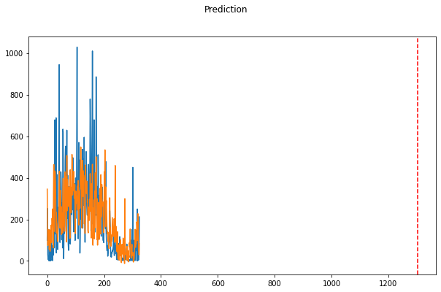
Model 1: Weather Analyzer
Validation plot of store 9
Architecture: LSTM input_size = 19 hidden_size = 40 num_layers = 1 num_classes = 1
Original
Predictions
Model Error: (for store no. 9)
RMSE of validation set: 8.262761878490158
RMSE of entire data set: 2.8291678845238453

Slide 8
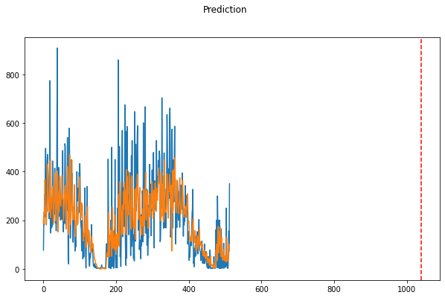
Model 2: Sales Analyzer
Sales Prediction plot of store 9
Architecture: LSTM input_size = 1 hidden_size = 15 num_layers = 1 num_classes = 1
Original
Predictions
Model Error: (for store no. 9)
RMSE of validation set: 5.6162163846431525
RMSE of entire data set: 3.0012314738081534

Slide 9
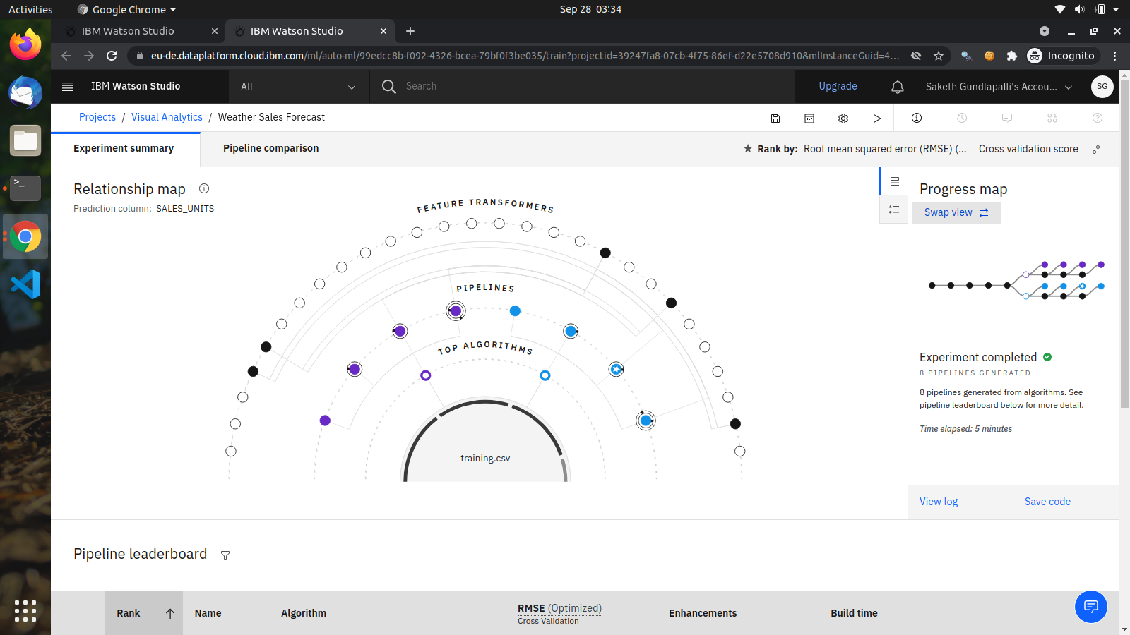
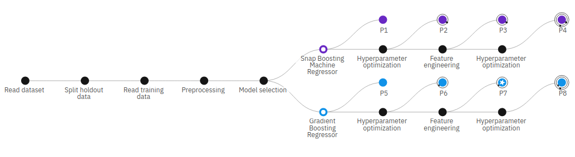
Model 3: Sales Regressor
Screenshots of
IBM AutoAI project
Architecture: Gradient Boosting Regressor
Model developed using IBM AutoAI and deployed at IBM Watson Studio

Slide 10
Sales Forecast
Ensembler
Sales
Analyzer
Sales Regressor
Weather Analyzer
Data Preprocessor
Weather Data

Slide 11
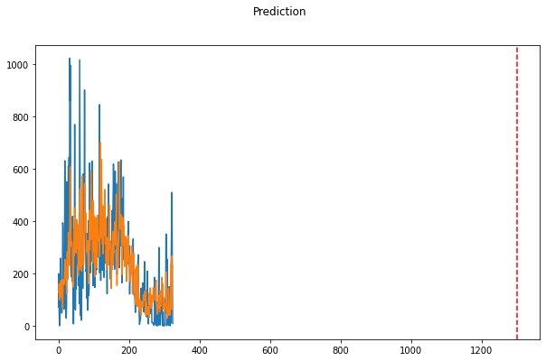
Ensembler
Sales Prediction plot of store 4
Architecture: LSTM input_size = 3 hidden_size = 40 num_layers = 1 num_classes = 1
Original
Predictions
Model Error: (for store no. 4)
RMSE of validation set: 7.831740415850558
RMSE of entire data set: 2.9187667413258356

Slide 12
Task 03
Recommending Order Units :
After Forecasting the sales data, the output from the ENSEMBLER is collected and used to recommend order units as follows:
We take the sum of all the fourteen day predictions of the sales
Assuming we already have 4 day sales at hand, we calculate the order units by (sum of fourteen day forecast) - (sum of 4 day forecast) = order units
We then calculate number of pallets required to cap the order units.
Since we already have total available area of side lot, we calculate the available space for order units
Sales prediction for next 14 days = 4984 Units ---- Assuming we have next 4 day sales on hand
On hand items = 1648 Units
Computing order units (number of bags) as 14-day sales forecast, minus on hand items
ORDER UNITS = 4984 - 1648 = 3336 Units. Since 16 sq. ft. space can be used to store 100 bags.
################### SOLUTION ###################
534 sq.ft is required to cap 3336 units of bags

Slide 13
HOW TO RUN
All the files, predictions and .pth files are generated in the project structure. One can run the notebook main.ipynb at project root and check the output

